Slide 1
PAVE THE WAY FOR SMARTER PARKING
@ THE INTERSECTION OF COMMON SENSE & INNOVATION
Notes:
Notes from 9/25 Call: Cristina will organize slides into sections with visual differentiation for transitions
Cristina edited all slides for consistency in capitalization, fonts, styles, etc.
Jason & team – Final QA review.
Different cover photo?

Slide 2
PAVE THE WAY FOR SMARTER PARKING
@ THE INTERSECTION OF COMMON SENSE & INNOVATION
Presented by:
Kurt Coduti, P.E.
Project Manager
Penn State Design & Construction
Luke Anderson
Parking Operations Manager
Penn State Transportation Services
Dominic Passanita, P.E.
Project Manager
Stahl Sheaffer Engineering
Notes:
Basic quick intros

Slide 3
OVERVIEW
Define a Complete Asset Inventory
Understand Network Level vs. Project Level Maintenance Strategies
Apply an Objective Methodology for Maintenance Prioritization
Optimize Expenditures and Pavement Conditions
Consider Project Planning and Construction
Notes:
KURT
For the past 7 years, Dom, Luke, and I have been working together on a comprehensive pavement maintenance program at the University Park campus and surrounding properties. Today, we’re going to share our progress in maintaining pavements for Transportation Services Group.
We’ll include info about why we started an official asset management program, the tools we developed, and how we use those tools to be more efficient in all stages of the pavement maintenance process.
When we started in 2017 with Transportation Services network, we had been through a year of pavement asset management with our University Park roadway assets. However, we didn’t have a complete inventory of the all the lots that were the responsibility of Transportation Services to maintain. The nature of the parking lot assets was different from the roads, so the tools we used to setup the roads program had to modified and adjusted to fit the non-linear parking lots.
The first step was to develop a good inventory.

Slide 4
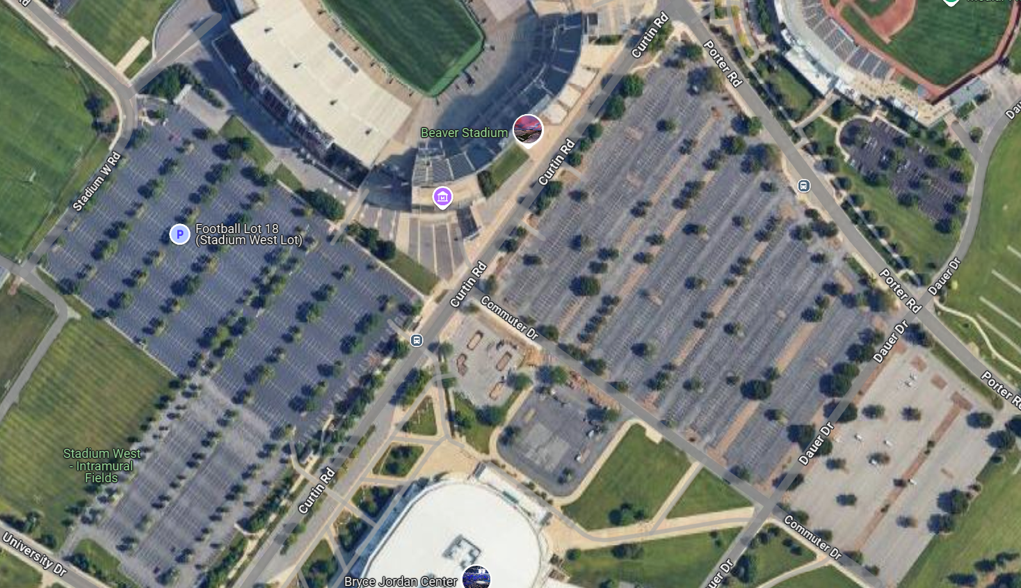
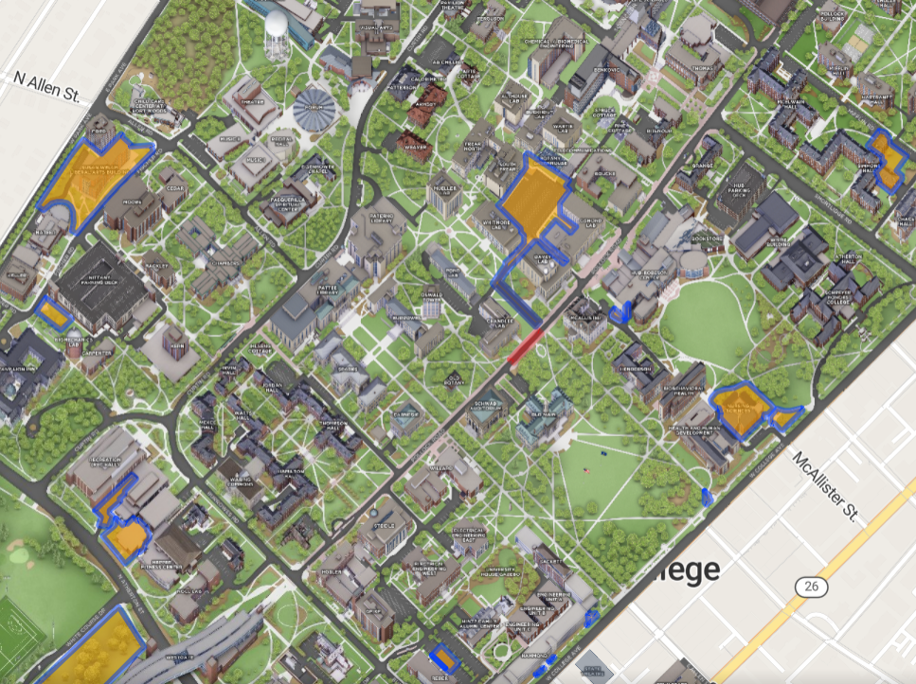
PROJECT GENESIS
DATA
Notes:
KURT
Cristina notes from 9/25 Call: Added different image from Kurt of different lot showing multi jurisdiction and lot issues (Stadium West & Jordan East/Lot 18 Google View), correct? Also added image of construction areas flying in – does this work, or should it be a separate slide?
Anecdotally, we knew that we needed a holistic solution that addressed the entire network of pavements as a group. The lots on the periphery could no longer be ignored until the pavements failed. This fact was even more clear after the inventory and condition assessments were complete.
At the onset, we recognized that the we needed to incorporate a mix of fixes to prevent “worst first” strategy. (example in photo. Not a TRS lot) This pavement has had years of patching potholes and utility cut repaving, without having a complete surface restoration. At this point, performing surface maintenance on this pavement is much more complicated that it could have been a few maintenance prior.
A cornerstone goal was to move away from having to reconstruct lots, like this one, and focus available resources to keep pavements in good condition throughout their service life. Full reconstruction of parking lots is expensive and very disruptive to campus operations.
Decisions about maintenance had to be data driven. The data and the analysis had to be objective and repeatable. For the program to be successful in the long term, performance of the program had to be measurable.
Dom is going to talk about what happened next on the process. Specifically, about condition assessments and prioritization tool we use.

Slide 5
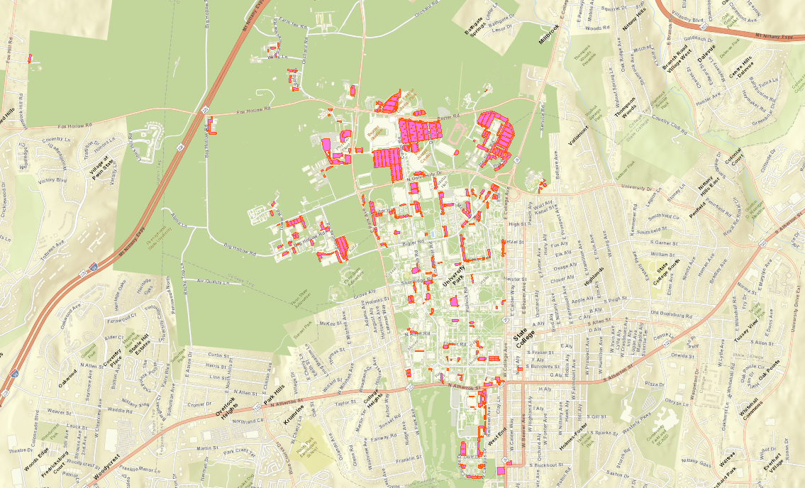
INVENTORY
Number | Total Area | Avg. Area of Lot
163 Lots | 478,000 SY | 2,917 SY
DATA
Notes:
KURT
Notes from 9/25 Call: Mention there are other lots covered through the road pavement project? (Not sure if I caught that correctly)
ADD NOTE ABOUT INITIATING PRIORITIZATION PLAN FOR ROADS END OF 2015 AND REALIZED THE VALUE IT WOULD ADD TO PARKING SURFACES AS WELL IN 2017.
When we started in 2017 with Transportation Services network, we had been through a year of pavement asset management with our University Park roadway assets. However, we didn’t have a complete inventory of the all the lots that were the responsibility of Transportation Services to maintain. The nature of the parking lot assets was different from the roads, so the tools we used to setup the roads program had to be modified and adjusted to fit the non-linear parking lots.
To complete an inventory, we had to sort through all the areas of pavement on campus. PSU keeps a very respectable GIS database of parking lots that they share for various purposes with the public, staff, faculty, and students. The GIS database was an excellent starting point for the inventory. However, there were other areas that were not clearly defined in terms of use or fiscal responsibility. Loading Docks, storage areas, and roadways through parking lots all made the inventory more complicated than it seemed at the beginning. In setting up pavement condition inspections, we weren’t sure what the limits of inspection needed to be to complete the data set on behalf of transportation services. It was decided to inspect all the pavements and sort out responsibility for the unknown pieces as the project moved forward. We’ve learned that new construction and changing operations make this effort continuous.
Transportation Services' inventory currently includes 163 lots, each identified uniquely with a number that was assigned to direct us to the area of campus on which it exists. The total area of pavement managed is 478,000 SY. The largest lot is Commuter Jordan East, at just over an acre of pavement. The lot serves daily commuters, frequent event parking, and has other uses throughout the year. It is an important piece of the parking network. Its importance is measured in our maintenance plans using a defined numeric ranking system.
The average lot is just under 3,000 SY of pavement. By comparison, not nearly as large as Jordan Center parking and many others are not nearly as visible. We learned there are many parking areas on the periphery of campus, which means they may not be on the radar of the maintenance managers until its too late for rehabilitation or there are “issues” with the serviceability or safety.

Slide 6
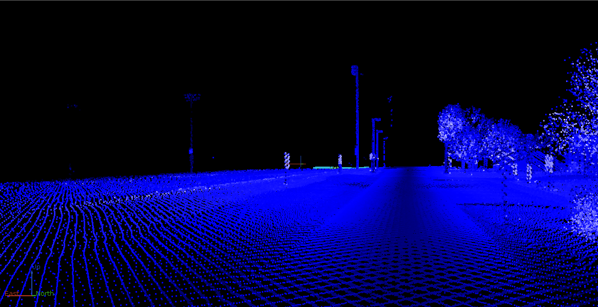
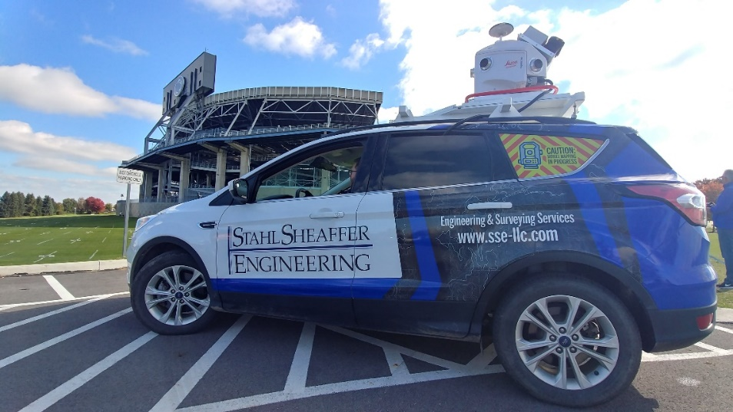
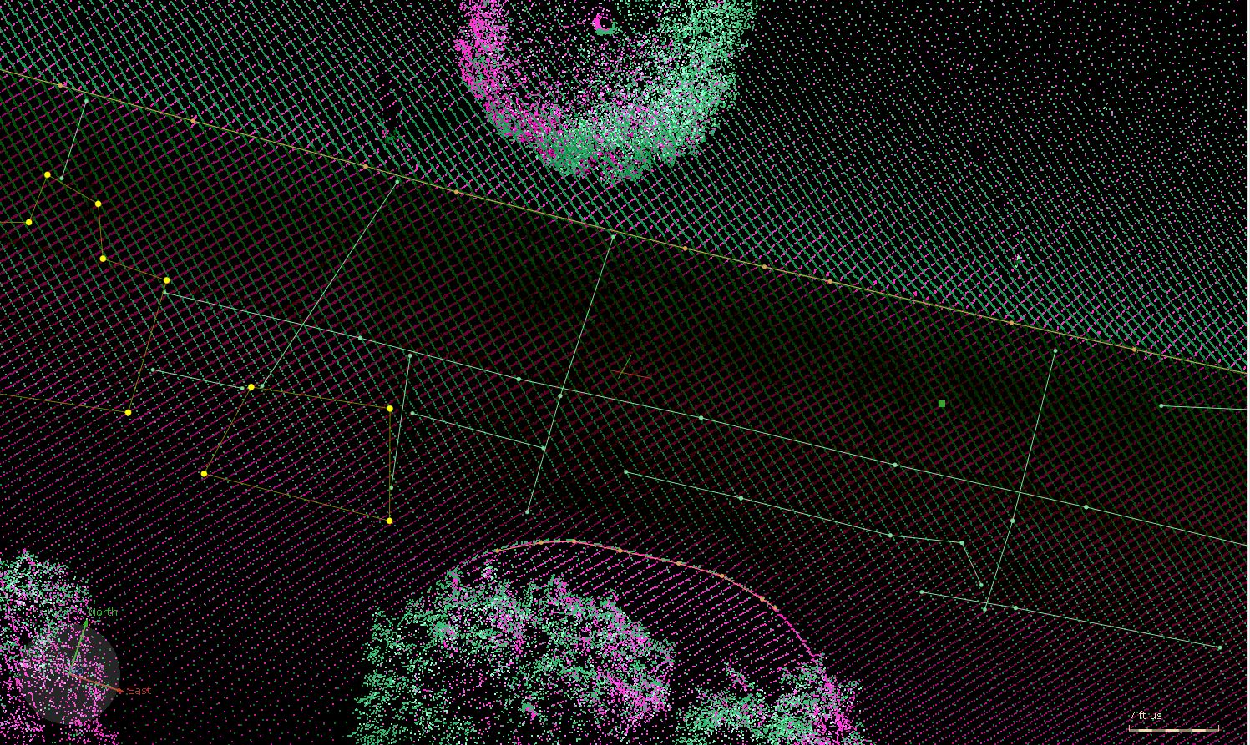
CONDITION ASSESSMENT: Data Collection
Mobile LiDAR:
Faster
Safer
Minimal Traffic Impact
DATA
Notes:
DOM
After we had our inventory mostly complete, we began pavement condition inspections, using our mobile lidar system.
Our mobile lidar platform allowed us to capture all the areas of pavement, create inspection data, and adjust the limits for fiscal responsibility concurrently. Mobile Lidar helped us create a snapshot of the field conditions. There are so many pavements in the network that conventional methods of inspection may not have been fast enough to keep up with changing conditions of the pavements.
Other benefits of Mobile Lidar for inspections:
Read Topics on slide
Limits of pavements we captured exactly
Condition data was consistent for objective analysis
Able to create distress features for every pavement distress on campus
Also extracted other relevant features that would affect construction, design, and prioritization of the pavement surfaces maintenance projects – curbs, bus stops, surface drainage, tree canopy, some signs, etc.
This process works by using the point cloud and imagery from LiDAR unit to extract or draw the distress features. The drawn polygons and lines that designate the type, severity and obviously size and location of each distress. The distress areas are then exported to our program as GIS files that we can use later for analysis. Though the mobile Lidar unit provides great improvement to walking the roads with a clipboard, we’d later improve our processes with new technologies.

Slide 7
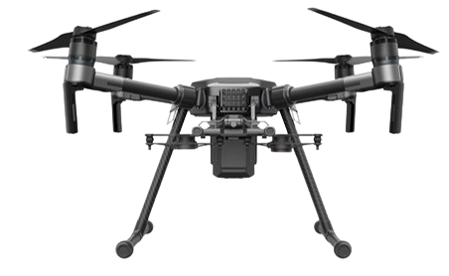
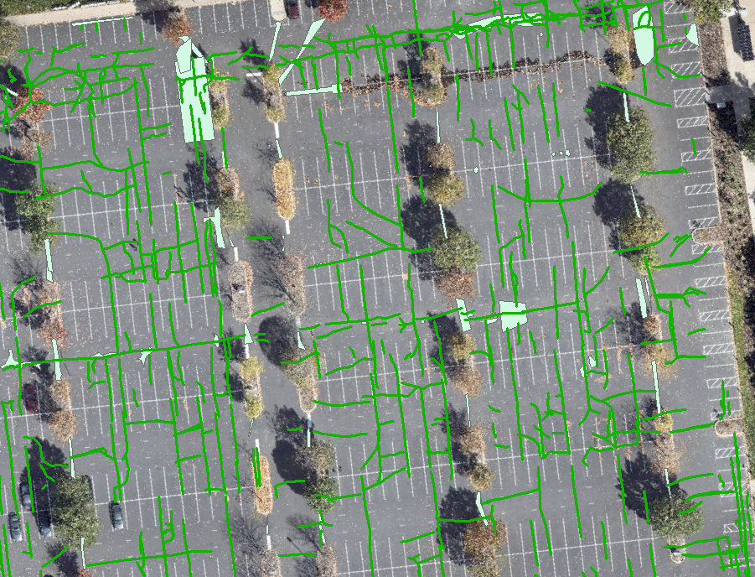
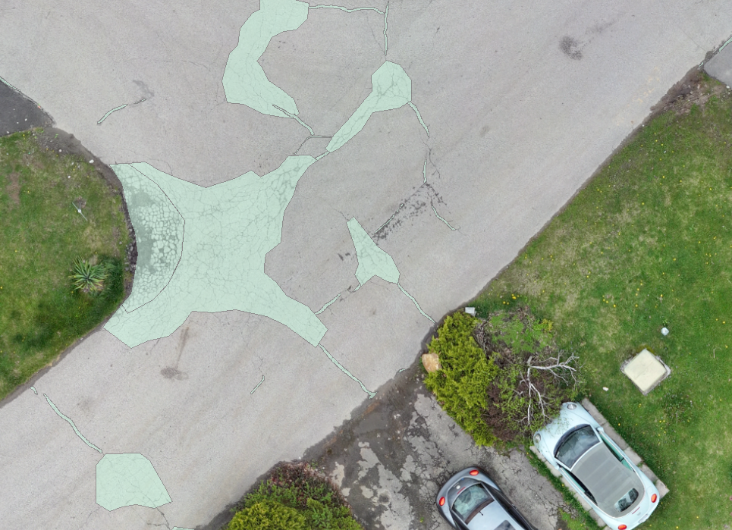
THE DIFFERENCE IS TECHNOLOGY
DATA
Notes:
DOM
In 2023, we began to incorporate some new technologies into the inspection process. The first was the use of drones to capture high-quality aerial imagery for the inspections. We also started to use AI to help us outline pavement distresses in both, the mobile and drone platforms. We could have an entire discussion about the benefits of AI in this application. The big takeaways are:
saves time,
more objective than human input, and
continues to get better with Deep Learning. Deep Learning is a continuous process in which “corrected” data outputs form the AI are fed back in the model to improve the algorithms.
We collected over 15,000 distresses at PSU this year. The photo on left is manual extraction.
The right photo is AI extracted features. These are different pavements areas.
Its worth noting that through our process over the last seven years, we have been able to keep good tabs on the condition of all the network pavements by inspecting roughly 1/3 of the assets each year on a rotating basis. Doing this helps to keep project soft costs to a minimum.

Slide 8
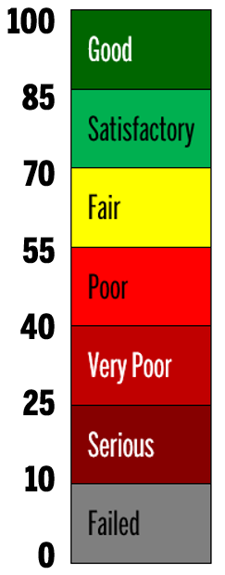
PAVEMENT CONDITION INDEX (PCI)
ASTM Standard Practice for Road and Parking Lots Pavement Condition Index Surveys (D6433-09)
Distress Type
Target of 85+
Distress Quantity
PCI
Distress Severity
Total Reconstruction
DATA
Notes:
DOM
Its great to have all those data points but if there is no action precipitated, what good are they? How do we deal with all that data?
We need that data to feed into our pavement rating system, PCI, which is from ASTM D6433.
The PCI boils all that data down to a single number between 100 and 0. 100 being the best possible condition and 0 being the worst. Above 85 is “good”. Anything below a rating of 10 is considered “failed”.

Slide 9
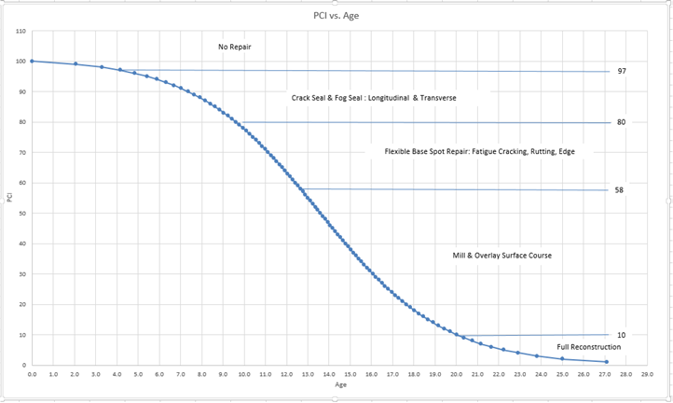
DETERIORATION & ROUTINE MAINTENANCE
Standard Maintenance Options – Zones along the deterioration curve that align with the anticipated modes of failure and expected repair need.
NO REPAIR
CRACK SEAL & SEAL COAT: Longitudinal & Transverse
FLEXIBLE BASE SPOT REPAIR: Fatigue Cracking, Rutting, Edge
MILL & OVERLAY SURFACE COURSE
10 years
20 years
FULL RECONSTRUCTION
DATA
Notes:
It is imperative that incorporate a mix of fixes the routine to plan for preventative maintenance and rehabilitation operations. The first order of business after the inspection is generalize the types of failure and establish the select maintenance operations that applicable to those general cases. After selecting the mix of fixes that we anticipate will work. We need to anticipate when to do them. Is just as important to make sure the right fix is implemented at the right time to maximize the benefit of available funding.
By knowing how the PCI rating system works, the type of pavement distresses that exist, and having a deterioration model for pavements, we can anticipate the types of maintenance that are needed, the quantities of those repairs, and the improvement value of those repairs.
For PSU, we use PennDOT deterioration model for the weather/ climate conditions around each campus. The model predicts the changes in PCI over the years of service life. And we use the PCI to quantify and qualify the types of pavement distress that are likely through the specific ranges of the PCI/ deterioration model.
Using unit costs for the expected type and quantities of repairs we expect for any particular pavement , we can estimate the total cost of the repairs recommended, or "prescribed" by the tool.
The next couple slides give us a visual of how our mix of fixes works in application.

Slide 10
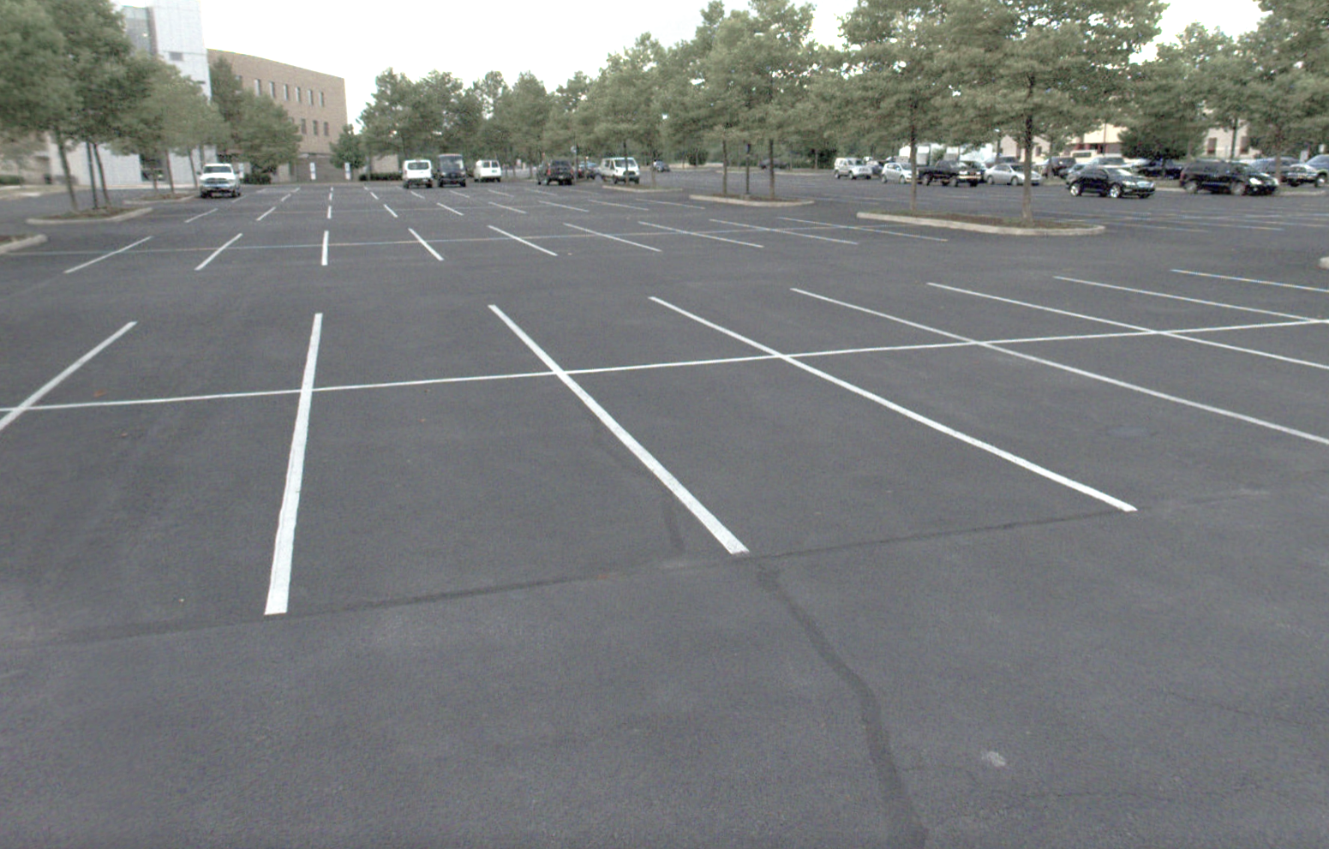
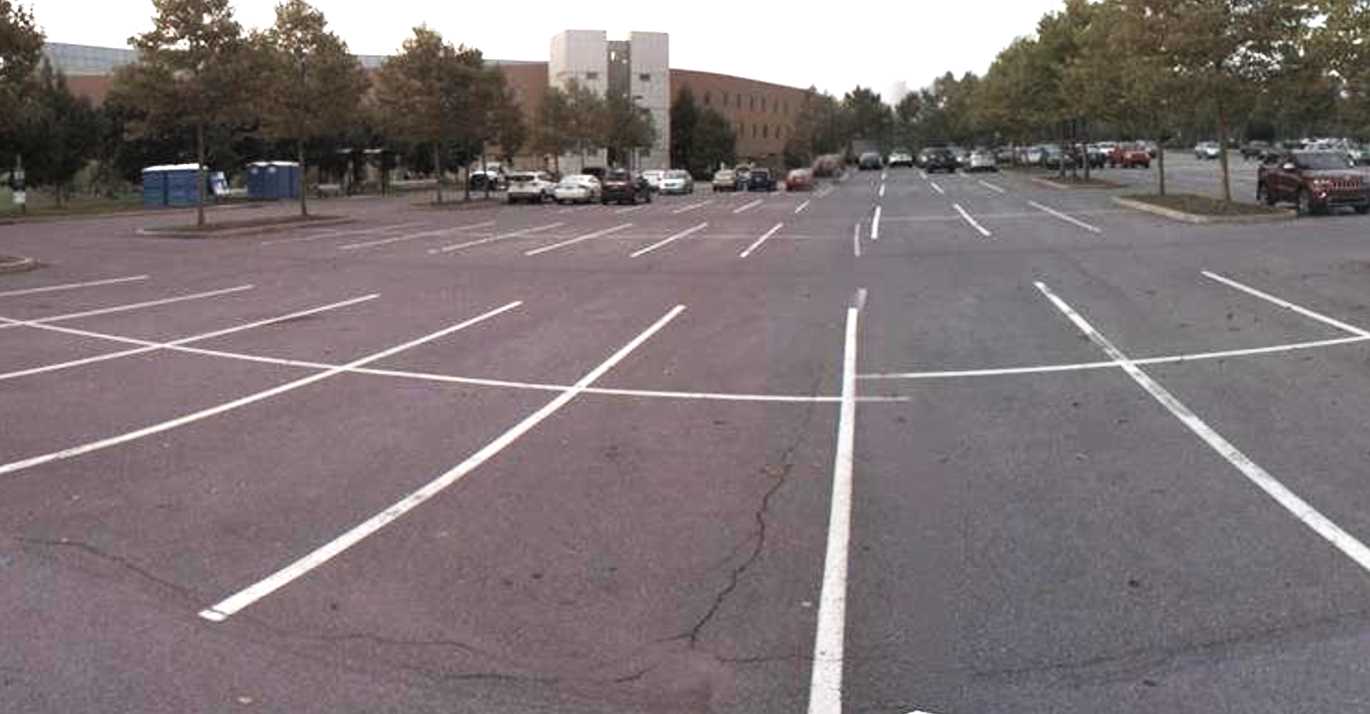
REPAIR OPTIONS
Crack Seal & Sealcoat
Upgraded PCI: 92
PCI Range: 80-97
Actual PCI
89
DESIGN
Notes:
If we start with new pavement having a 100 PCI, we expect and budget for preventative maintenance as a first order of business.
Talking about pavements that range in PCI score between 80- and 97. In this region our pavements are rated "good“ and “satisfactory” We do what we can to keep those assets in this range. Users and maintenance managers are happy here in this range. These pavement generally look nice, perform well, and the preventative maintenance necessary in this region is relatively less expensive and causes less disruption than rehabilitation options.
PHOTO Discussion
The inspection of this pavement, in combination with the PCI methodology, told us this pavement has score of 89. There are some medium severity longitudinal and transverse cracks and some low severity depressions in the pavement surface.
We typically perform crack sealing and sealcoating in this region to reduce the severity of the distresses in the pavement from “medium” severity to “low” severity. The reduction of distress severity increases the PCI score from 89 to 92. This is how we “buy back” pavement service life in our program.

Slide 11
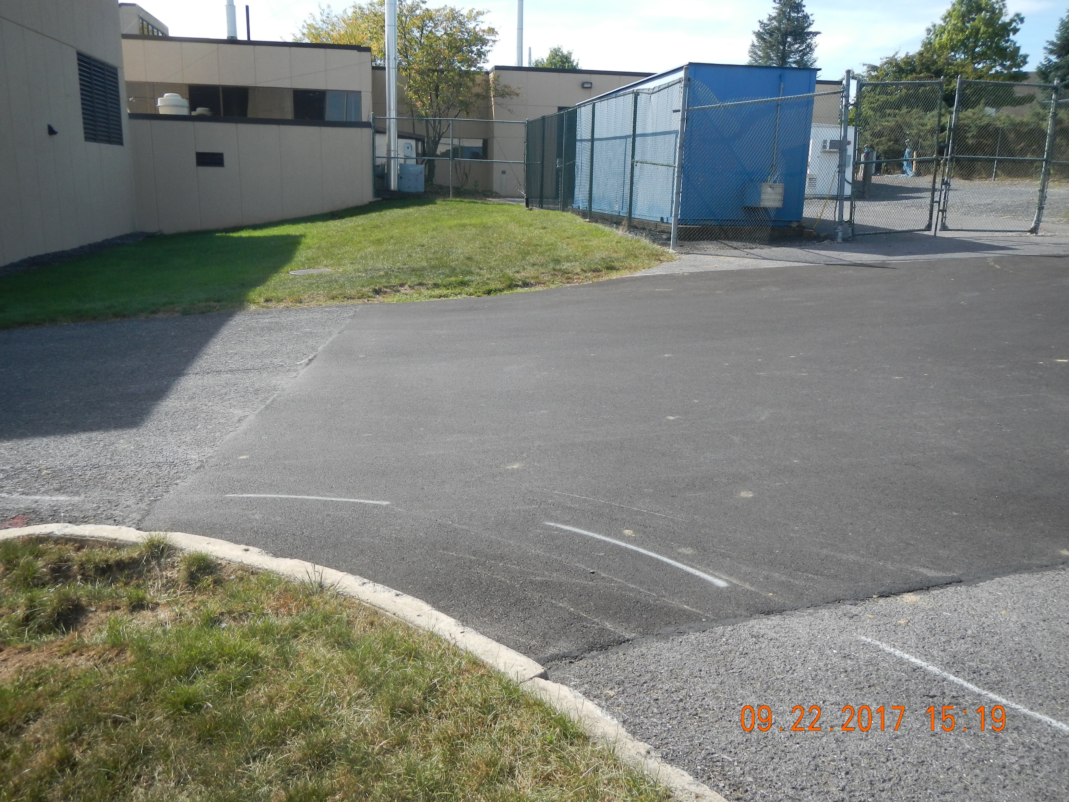
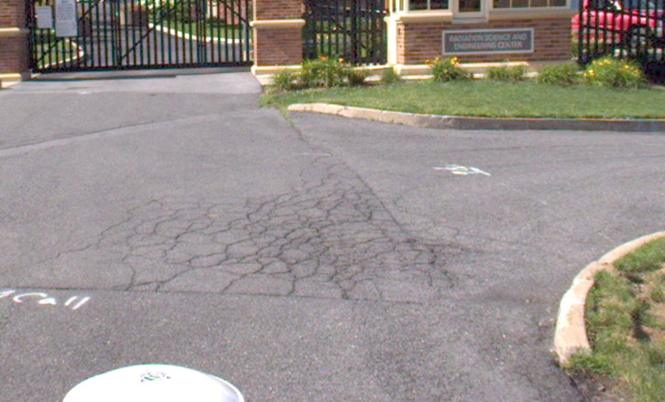
REPAIR OPTIONS
Flexible Base Repair (FBR)
PCI Range: 58-80
Upgraded PCI: 77
Actual PCI
60
DESIGN
Notes:
Our Flexible Base Repair Maintenance Option is implemented when pavement distress can no longer simply be sealed.
Even though we keep up with crack sealing and preventative maintenance, eventually traffic loading and freeze thaw cycles will widen surface cracks that propagate into fatigue cracking/alligator cracking. This type of cracking indicates damage of all the layers that comprise the pavement structure. This type is damage is usually isolated, so replacing the pavement structure and compromised subgrade in isolated areas make sense for a repair type.
According to PCI deterioration chart from the previous slide, isolated patching is expected to be the right fix for pavements in a wider range of named condition ratings. Pavements that rate in the satisfactory, fair, and poor conditions are expected to be economically improved with this isolated flexible base repair option. In a similar fashion to cracks that are sealed, the areas of pavement that are patched are still considered defects in the pavement. A patched area does not deduct from the pavement score as much as the same area of alligator cracking or pavement rutting would.
The photos in the slides indicate the range of PCI and “repair effect” of flexible base repair.

Slide 12
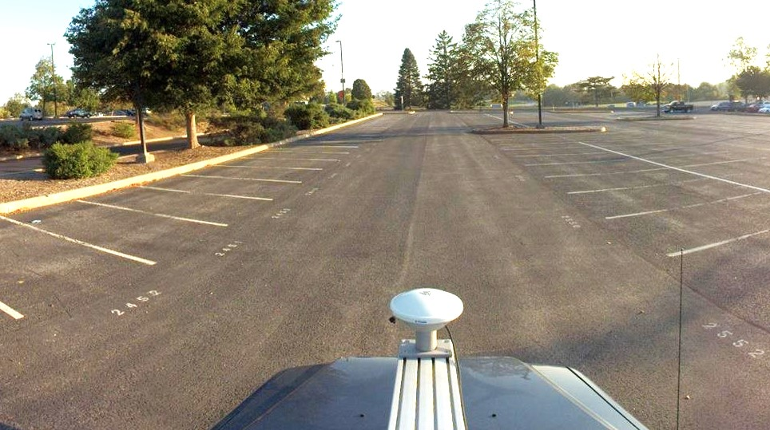
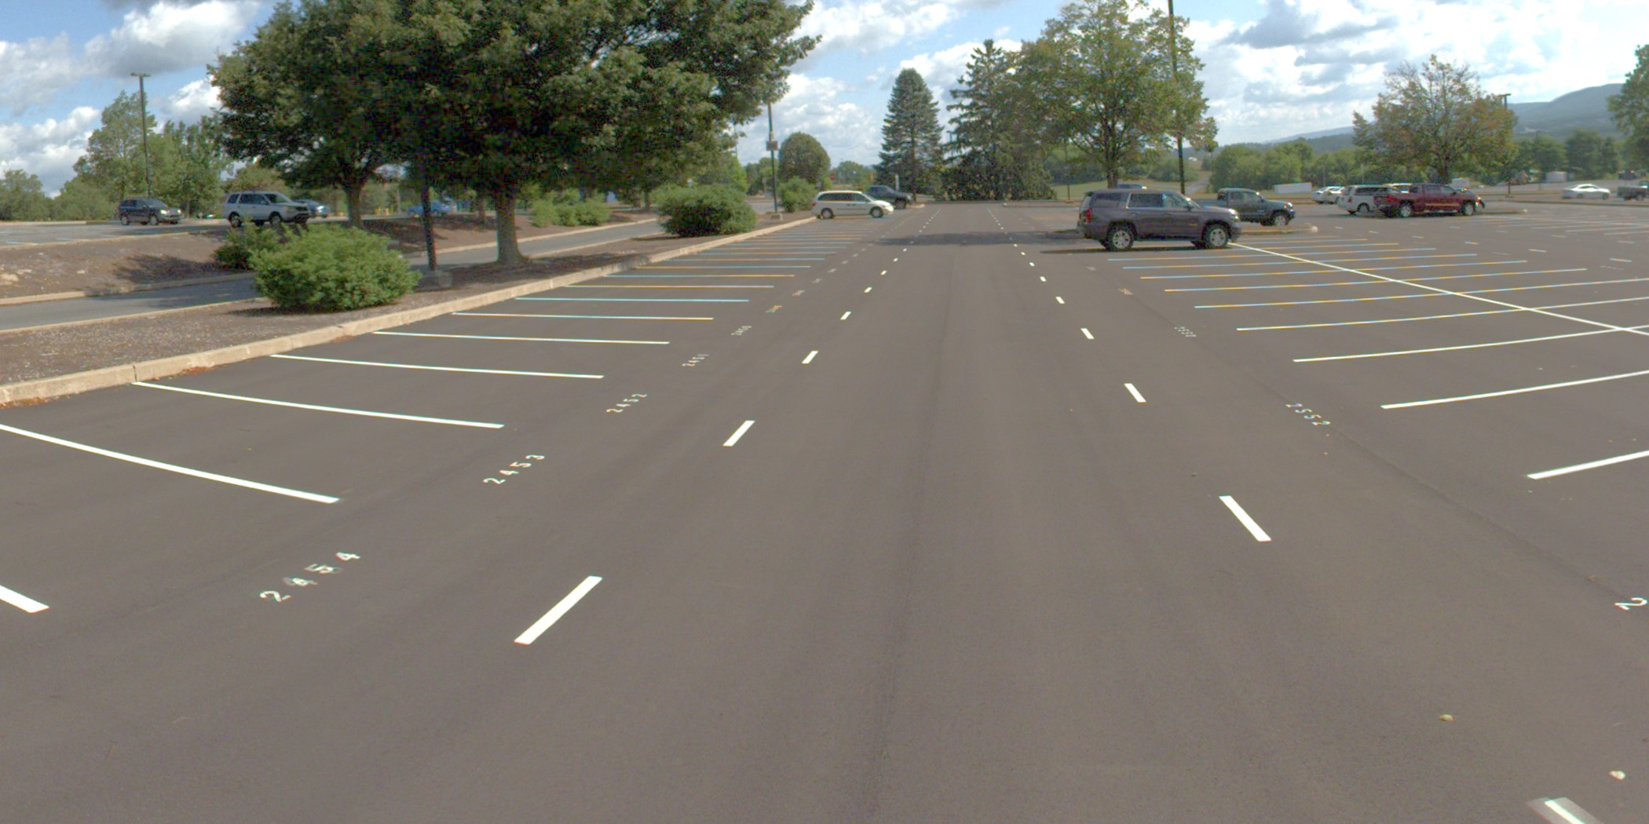
REPAIR OPTIONS
Mill & Overlay
PCI Range:
10-58
Actual PCI: 62
Upgraded PCI: 100
DESIGN
Notes:
Rehab – resurfacing entire length and width.
There is a point at which patching by itself no longer becomes a viable option for pavement rehab. From a practical standpoint, how many patches are too many in a single pavement? The PCI calculations confirm what’s easily observed. Don’t forget the patches, even in a good condition, are pulling down our PCI score.
So at about 17 to 20 years after a pavement is new, we should budget and plan to replace the wearing course, which is typically the top 1.5” of the entire pavement surface.
After we perform this option, we’ve removed all observable distress in the pavement surface, which means we get that surface PCI rating back up to 100. resurfacing is the economical choice when the PCI range is somewhere between a PCI of 10 and 58. Depending on where within the range we rate a particular pavement, we plan and budget for additional base repairs to be completed as a preparation step for the resurfacing.
When we see PCI below a value of 10, we are likely going to need to replace all the base course. At this point there is just no thing worth trying to save from a constructability standpoint.

Slide 13
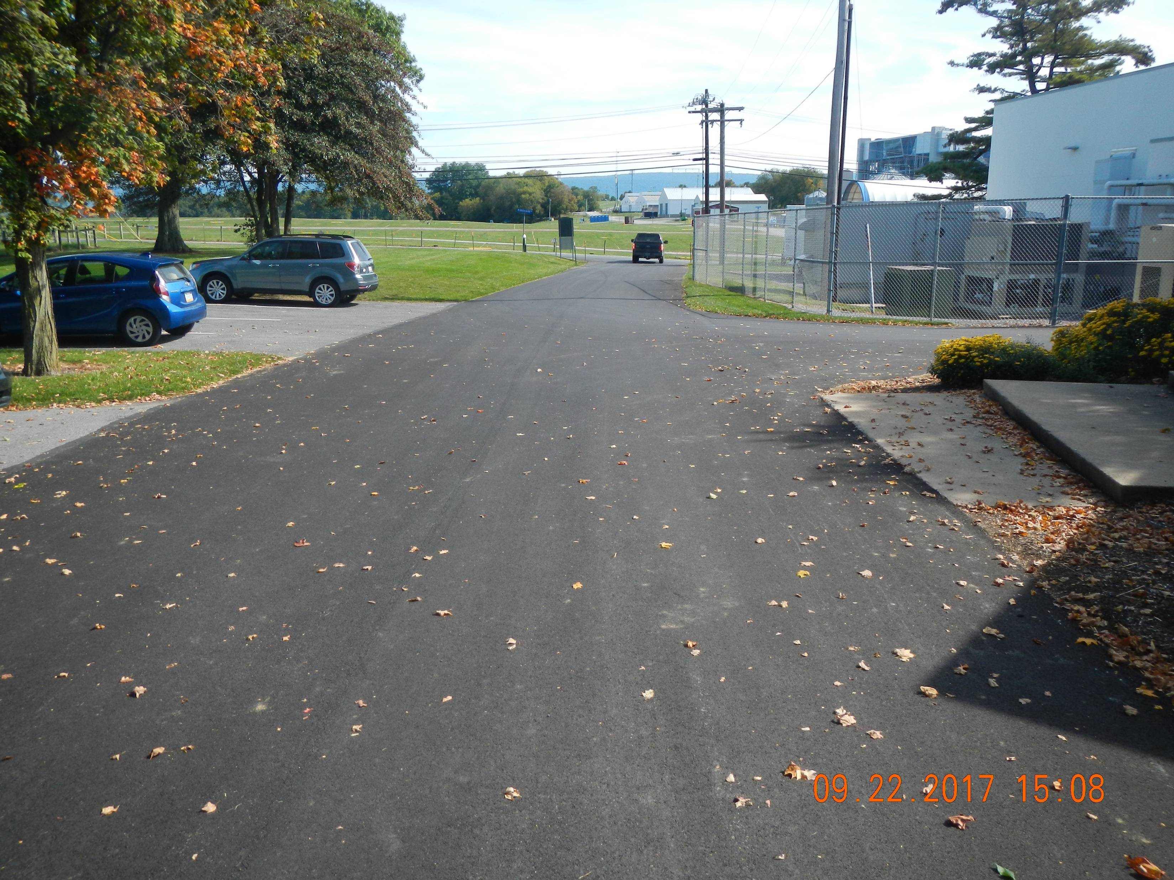
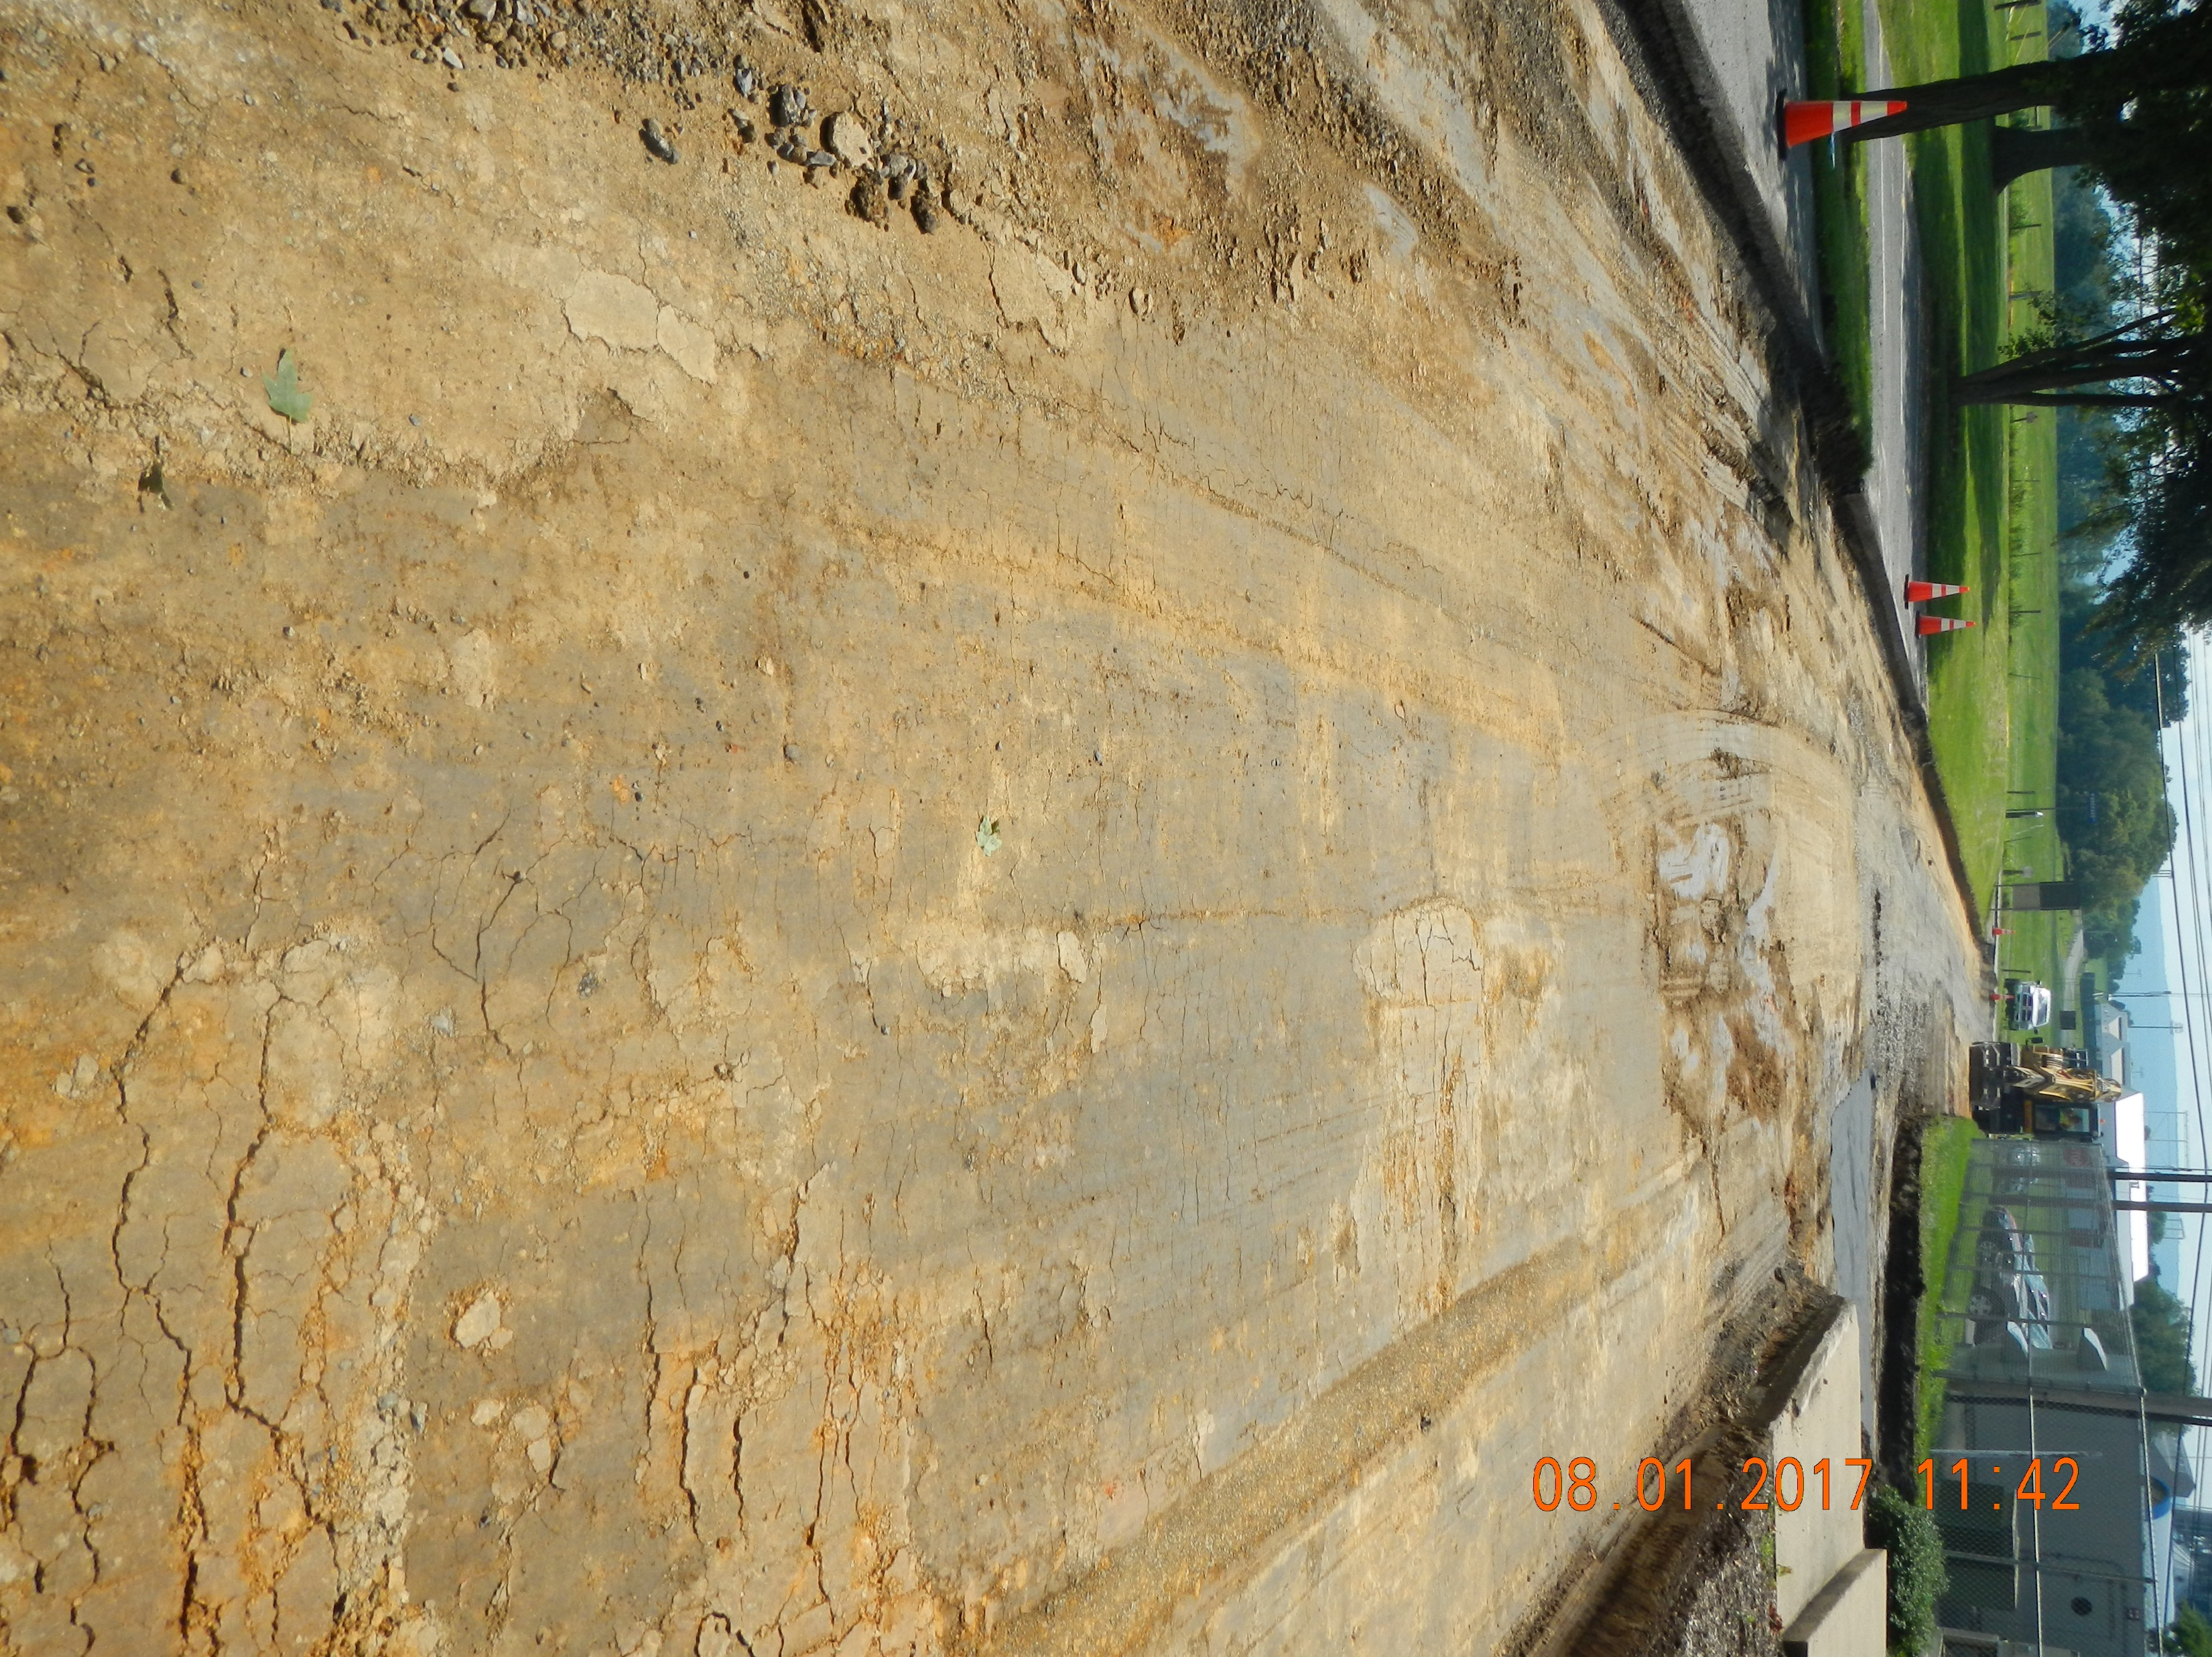
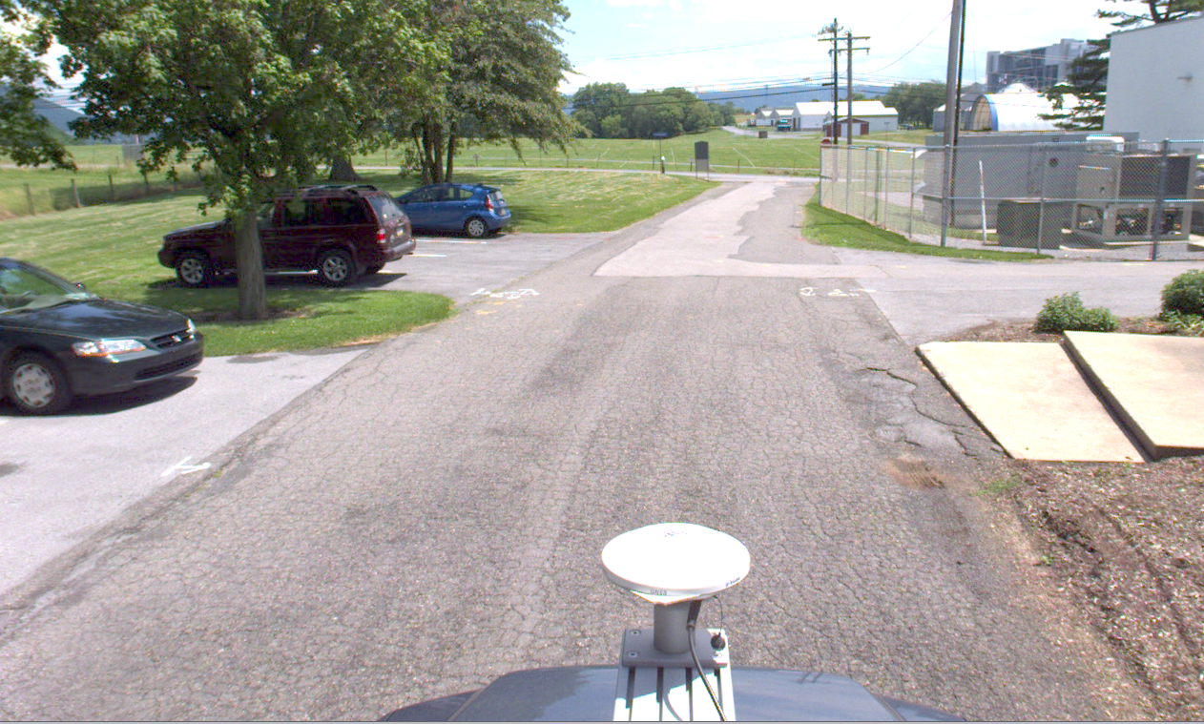
REPAIR OPTIONS
Full Reconstruction
Upgraded
PCI:
100
PCI Range: 0-10
Actual PCI
13
DESIGN
Notes:
Reconstruction – we want to avoid. It’s the most expensive option there is. If we are truly maintaining pavements, we should never need to get to this point.
Full reconstruction is when we remove everything down to the subgrade or native soil and rebuild the entire pavement section, literally from the ground up.
IN the photos, the PCI wasn't exactly in the range for full reconstruction, but it was obvious during the field view that full reconstruction was the proper option.
Its worth mentioning, pavement may also need to be rebuilt when utilities beneath require replacement or when there are factors other than maintenance are at play. For example, when a planned major change in use requires a redesign of the pavement section depth, etc. Sometimes use of a particular pavement increases slowly over time, which creates a situation in which the original pavement design is insufficient.
Again, our goal as maintenance managers is to completely avoid full depth reconstruction. Reconstruction uses funding that could be used to keep our other assets in better condition.

Slide 14
FORECAST
 | 5-Years | 10-Years | 20-Years
Total Expense: | $4,544,802.81 | $11,898,545.37 | $21,083,542.49
Average Yearly Expense: | $1,197,158.49 | $ 1,189,854.54 | $ 1,176,408.45
Average PCI: | 84 | 84 | 82
Forecast - Unlimited Budget
 | 5-Years | 10-Years | 20-Years
Total Expense: | $4,544,802.81 | $16,934,496.36 | $25,950,393.62
Average Yearly Expense: | $1,344,355.93 | $ 1,693,449.64 | $ 1,778,308.36
Average PCI: | 85 | 86 | 85
Forecast - Limited Budget
PLAN
Notes:
DOM
We also use our pavement maintenance prioritization tool help us plan in two distinct ways. Short term project planning.. This is what we do to help select the projects we are going to scope, design and bid each year. We also use the tool to help us discuss and optimize funding over longer-term periods. We want to put ourselves in a position in which we have adequate funding to “keep up” with changing conditions of pavements in the network. With the tool, we’ve confirmed that “keep up” scenarios are always less expensive in the long run than “catch up” scenarios.
How does the maintenance prioritization tool work to give us the outputs we need?
Our maintenance prioritization tool uses the pavement distress data to calculate a PCI for each parking lot.
The PCI score determines what type of maintenance needs to be done to the pavement.
From there, we apply unit costs to the quantity and type of repairs we expect to be needed on a yearly basis for each parking lot.
Based on the PCI measured in the first inspection, each parking lot follows the maintenance routine that we just discussed in those “before and after” photos and the deterioration model graphic.
When we investigate budgeting options, the maintenance prioritization tool ultimately compares the cost estimates for the individual projects and our available budget to tell us which projects should be our priorities. The tool calculations are set to consider
the importance ranking of the asset in comparison to the other assets in the network,
what maintenance was performed in the years immediately prior,
the overall benefit or expected increase in PCI if the “prescribed maintenance” is actually completed (this is called "optimization").
When we budget, we pay particular attention to 1 yr projections, so we know what to do the coming year. we also look at other key metrics - a 5-year rolling budget and 20-year total expenditure. The tool is flexible in the fact we can observe the year-over-year changes in the expected condition of the network based on the anticipated expenditures. We can investigate an unlimited number of budgeting scenarios for any relevant period. We can also look at things such budget deficits, cost of deferred maintenance, and yearly backlog. We can tie any of those metrics to specific condition outcomes that are interesting to us.
The example above shows two budgeting scenarios that we may compare. There nothing super interesting in this example. It is what we would expect. More funding means better overall condition rating at the end of any period.
I’d be happy to quickly demonstrate some other budgeting concepts after we finish the presentation. For now, we need to stay on track. Luke is going to provide some additional details of the yearly planning we do to advance projects from our tool into construction.

Slide 15
PROJECTS IN ACTION
Walk the list of projects together to determine the exact scope.
Review construction documents, bid, award
Quickly begin aligning construction schedules with campus operations
Contractors go to work
PLAN
Notes:
LUKE
As Dom stated we use the tool to help us pick a list of projects to complete each year. We call that list of projects from the tool. “prescribed repairs”. The list of repairs doesn’t become “proposed repairs” until a design is complete, and a contract developed.
we send our list of "prescribed repairs" to any stakeholders that may have some input on the construction and coordination of work we are thinking about doing. Their input and feedback helps us decide whether we advance any prescribed project into design. During this period, others are encouraged to provide their facility’s blackout dates and times when construction would disrupt operations.
We use all the input to adjust our list of potential projects. We repeat the process and adjusting the list until all stakeholders agree on the list. In simple terms, this process makes sure we are out of each others way and not proposing an expensive fix for a pavement that will be torn up or removed in the near future.
We also get many questions during our planning period about future paving plans. Because we have along term plan that includes a list of repairs for every pavement in our network, , we let folks know when we plan to address their concerns.

Slide 16
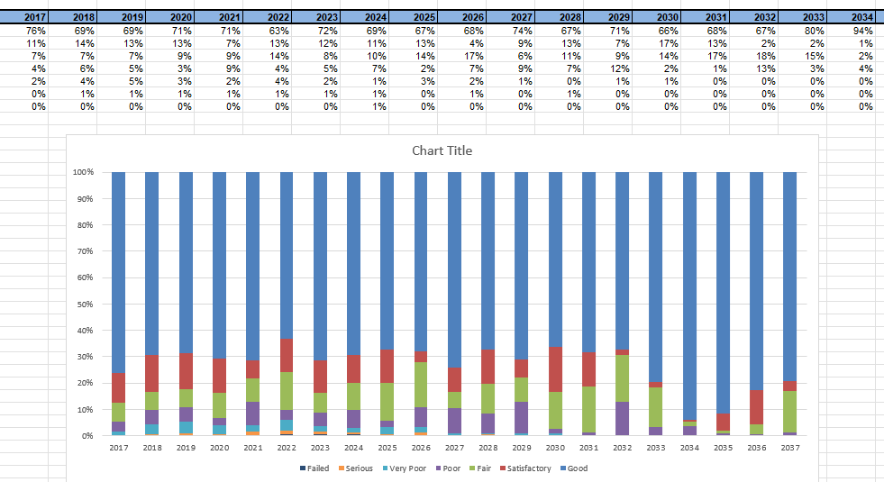
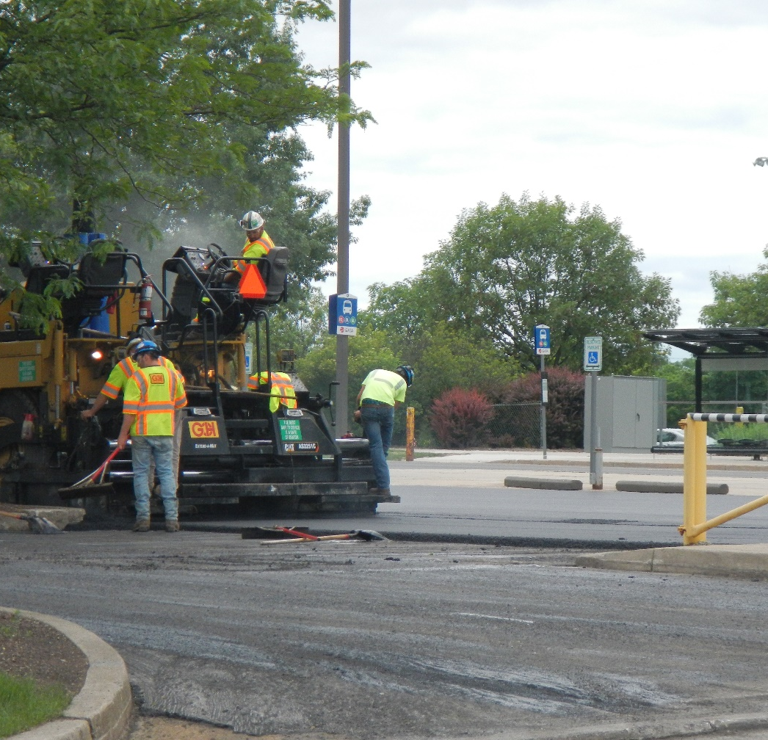
NETWORK PLANNING vs. PROJECT PLANNING
PLAN
Notes:
Notes from 9/25 Call: Add additional slides showing: weekly schedule with contractors. internal daily briefings/email briefings from Jason.
Cristina will add a screenshot of excel schedule to the slides (received access from Kurt) and screen shot or links to interactive mapping (received link from Jason).
Luke – send photo of Signage /Parking Lot with Sign Showing Construction Activity
LUKE
The planning we did with the tool and our imagery data helps us to determine where to begin and what to expect within our network. We call that network planning. It doesn’t give us the exact answer for each pavement, but it gets us very close and provides a budgetary estimate. The network planning ends when we’ve finalized our lists with the other stakeholders. Its at this point that we are done with our complicated spreadsheets and complex calculations. We are ready to begin project planning.
Project planning begins with field views to finalize scope and confirm constructability of the projects that we propose. We take our lists and maps and head to the field to verify scope, estimated quantities, and make our last notes before we advertise, bid, and award.
Because we a have a very short construction period, when there are significantly less people on campus, we move quickly through bidding and award and begin aligning construction schedules with campus operations. We want to get to work the day summer break begins and wrap up as quickly as possible.
After contractors go to work, Transportation Services is constantly busy with communicating plans to affected parties, dealing with complaints/ concerns, and ensuring vehicles aren’t in the way of the paving contractor.

Slide 17
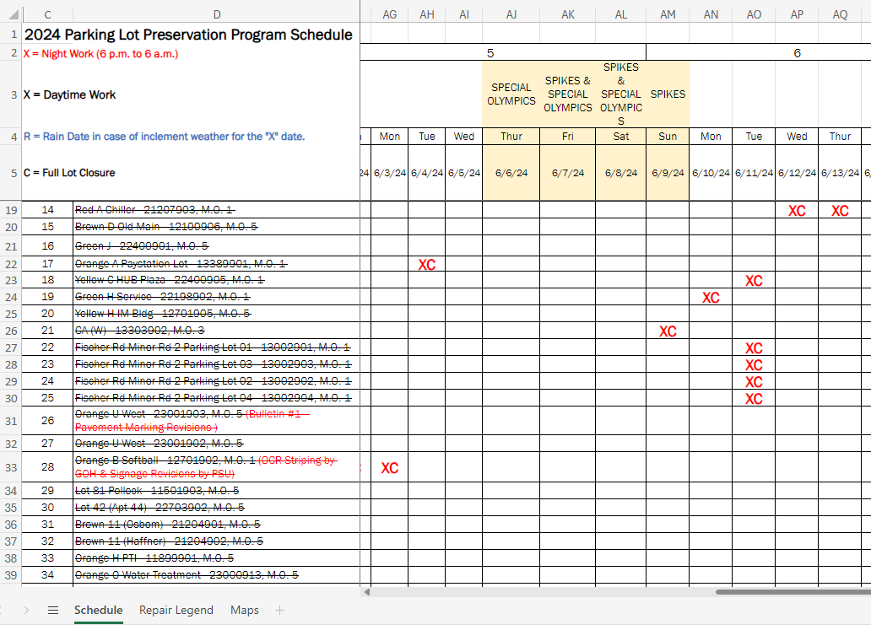
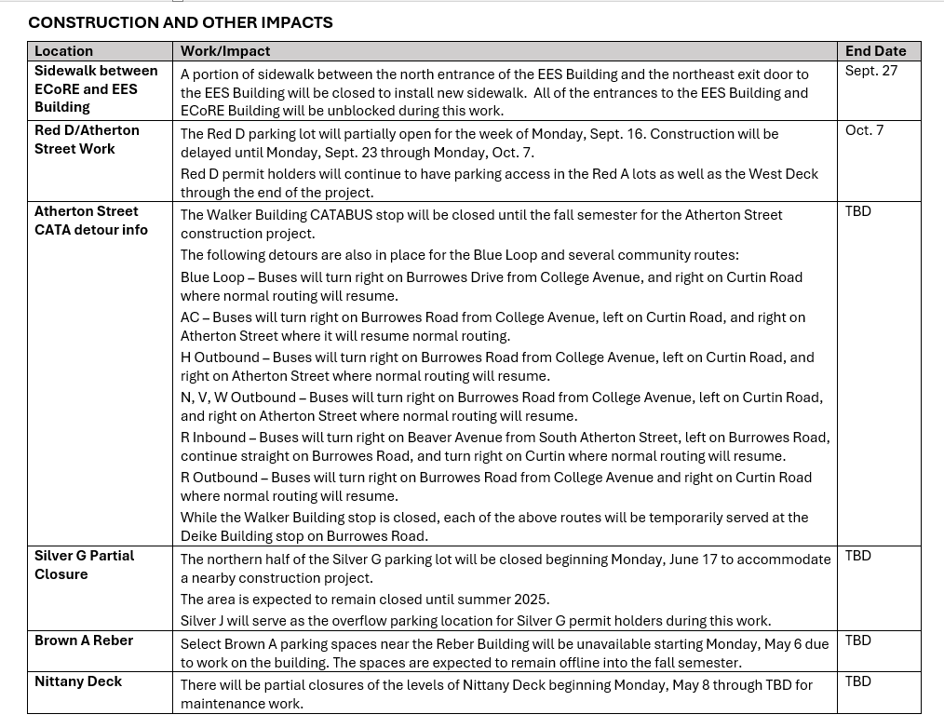
NETWORK COMMUNICATIONS – Internal ???
Daily Briefings & Program Schedule
MANAGE

Slide 18
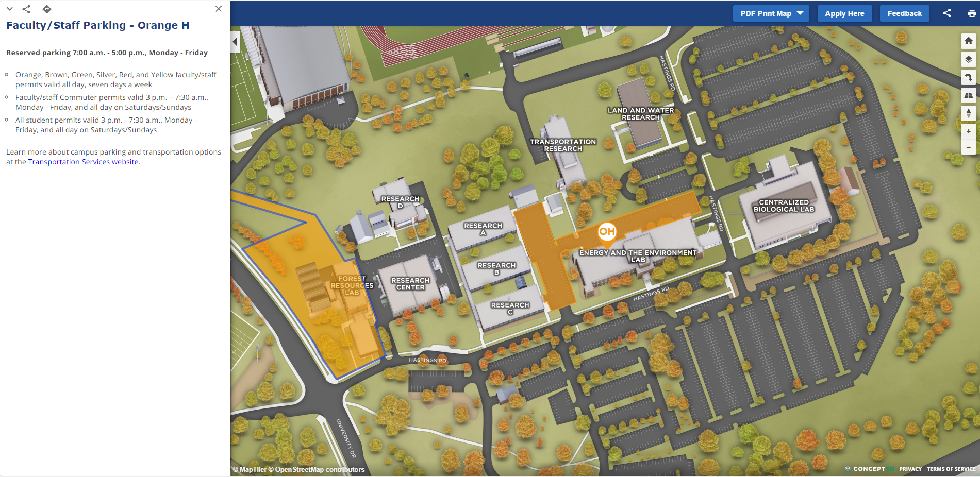
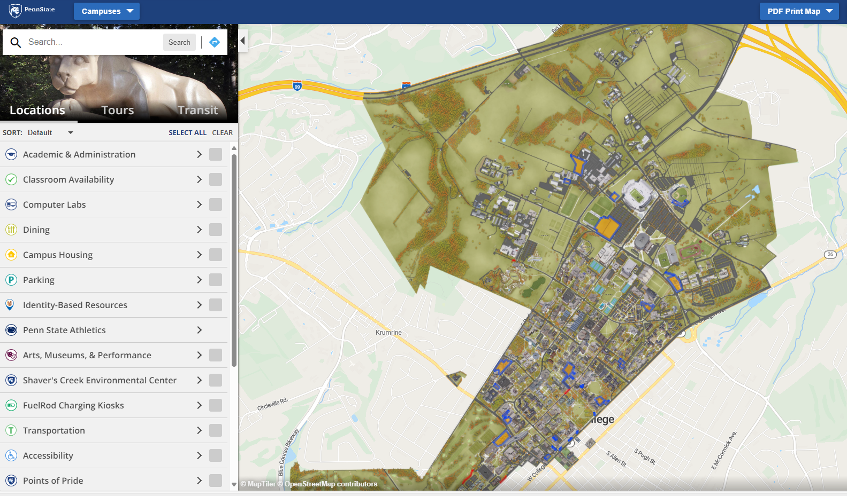
NETWORK COMMUNICATIONS – Public ???
PSU Interactive Map
MANAGE

Slide 19
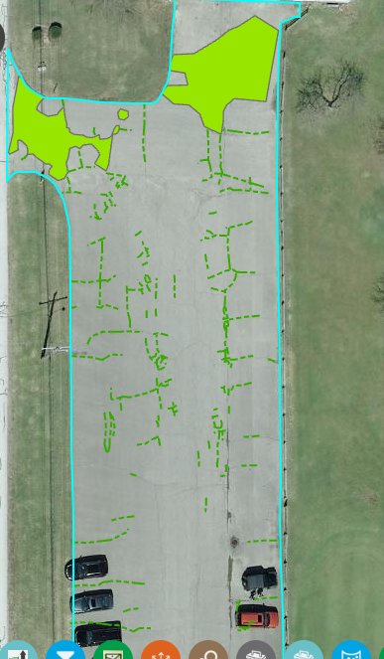
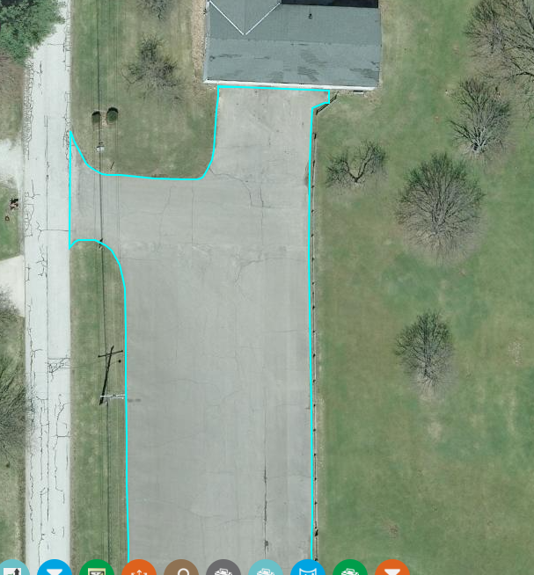
PROACTIVE MAINTENANCE
Does it Work?
2019
PCI 20
RESULTS
Notes:
Luke
PSU transportation services has 6 years of construction under this program our belts. How is going? The short answer is “pretty good.” Leadership understands the importance of a proactive approach.
Since 2018 , we’ve completed 241 pavement maintenance projects on Transportation Services parking lots and spent roughly $6M.
When we started, the network was in relatively good condition on average. 95% of the network was rated by the PCI system as having at least a “fair” rating, and there were no immediate failures noted. As we move into 2025, the metrics are about the same, which indicates our level of spending is dialed in. We can “keep up” the network rather than “catch up”.
What’s the difference in keeping up vs. catching up? Keeping up means we are avoiding the cost of deferred maintenance. This happens only when the available funding covers the projected cost of maintenance year over year. For a yearly pavement maintenance program, the cost of deferred maintenance must also consider the additional deterioration that happens during the period in which maintenance is deferred. Deferred maintenance also means additional inflation costs are likely to be realized during the period in which we wait for funding to be available.
The results of having a pavement maintenance program are in the numbers and statistics. We realize the results more easily looking around campus at the projects we have completed. Let's look at some slides to exemplify the importance of proactive maintenance when it comes to pavements.
Its all about doing the right fix at the right time.
On the left, we have an aerial image of a pavement taken in 2019. On the right, the pavement deficiencies are marked that that result in a pavement score/PCI rating of 20. At this point, the pavement maintenance prioritization tool was prescribing ”mill and overlay surface course” to restore the PCI to 100. Using the deterioration curve Dom talked about, the deterioration model previously discussed, total failure was expected to happen in 2021. The tool predicted there were about 2 years left before the pavement could non longer be rehabilitated.

Slide 20
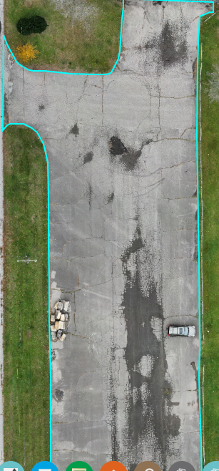
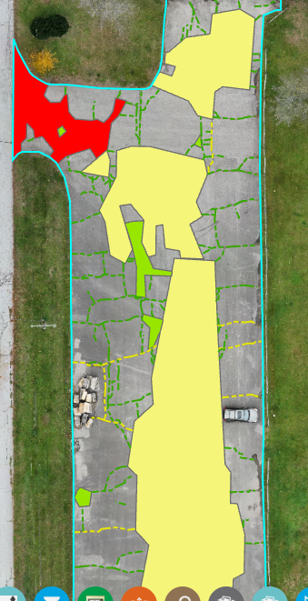
PROACTIVE MAINTENANCE
Does it Work?
2023
PCI 3
RESULTS
Notes:
Jump ahead to 2023.
The recommended overlay was not performed due to a lack of funding.
Again, the drone shot on the left was collected during the next inspection that happened in 2023. The resulting pavement deficiencies that were outlined for the condition inspection are seen on the right. The PCI is of the pavement in 2023 was measured to be 3, well below the expected failure at a rating of 10.
In 2023 the tool is prescribes total reconstruction as the only repair option. Based on what we can see with the phots in in the field, it seems that the tool got this right. The base failures we see in 2023 are perversive. Meaning, we can no longer construct isolated base repairs on this piece of pavement or simply cover it up with an overlay. The whole thing needs to be replaced.

Slide 21
PROACTIVE MAINTENANCE
Delay = $Dollars
2019
2024
$126K Overlay Recommended
$400k+ Total Reconstruction
RESULTS
Notes:
What does this mean in terms of dollars?
In 2019 the tool recommended a $126,000 overlay, which was doable with the pavement in the observed condition.
In 2024 we are looking at a bill of over $400,000 for a total reconstruction of the pavement and curbs.
The cost of deferring maintenance for the 5-year period is $274k. By not being proactive, we lost our opportunity for the less expensive fix and experienced inflation on the option we have remaining.
We also must consider that the “extra” $274k needed now for this parking lot could have gone a long way in funding other pavement preservation projects in this network.

Slide 22
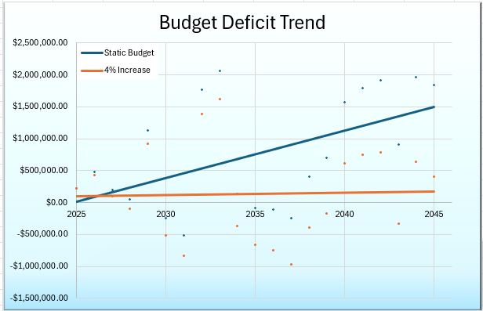
CATCH-UP vs. KEEP UP
Catch-Up
Keep-Up
RESULTS
Notes:
Note from 9/25 Call – Will change or remove this
DOM
The graph trendlines shown here compare the catch-up scenario to the keep- up scenario in terms of budget deficits.
The blue graph is what happens when we are not keeping up. Year-over-year the budget deficits increase when the available yearly budget holds steady at a set number and that set number isn’t enough to all that needs to be done.
The orange trend line shows that a 4% increase in yearly funding. This 4% increase is enough to ensure we remain in that comfortable “keep-up” situation. Using this trendline, we can see that year-over-year our budget deficit is not increasing. in a practical sense, we are avoiding the costs of accelerated deterioration. We have the right amount of funding to do the right fix at the right time.

Slide 23
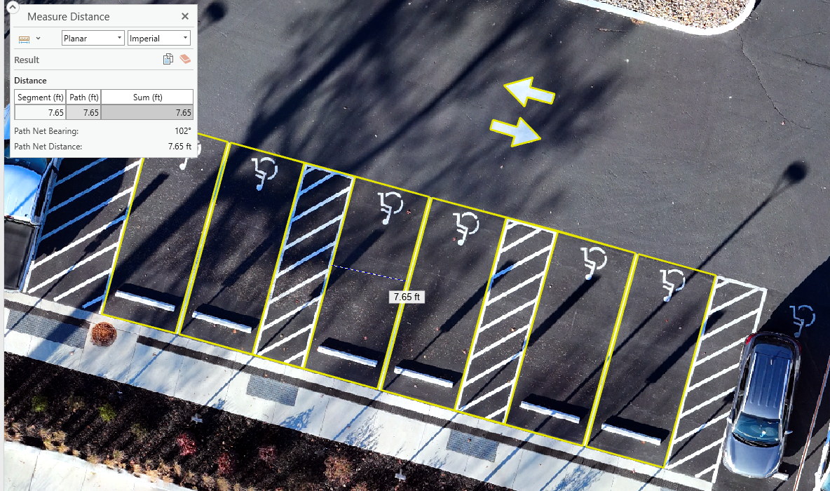
NEXT STEPS
Notes:
KURT
Stay focused on our core missions.
Continue to monitor our progress and identify other areas of improvement and efficiencies
Continue defining fiscal responsibility as new buildings are built, etc.
Improve collaboration and communication with stakeholders, clients, and departments during project planning phase.
Use our planning tools to compile efficient construction packages that entice contractors to bid and execute.
Innovative uses:
Use tool budget outputs with other budgeting efforts – parking pass cost, others???
Use the inspection process and imagery for other efforts on campus
Pavement markings and signs – ADA and lot identification signs – parking facility mapping was used
Preliminary scope and planning of other improvement projects. The aerial imagery collected is current. Saves trips to the field.
History – we know when work was performed and its archived for others that follow us
PHOTO OF ADA LOTS – currently working on AI routines that run concurrently with our pavement inspection routines to count, measure, and assess adequacy of ADA parking spaces.

Slide 24
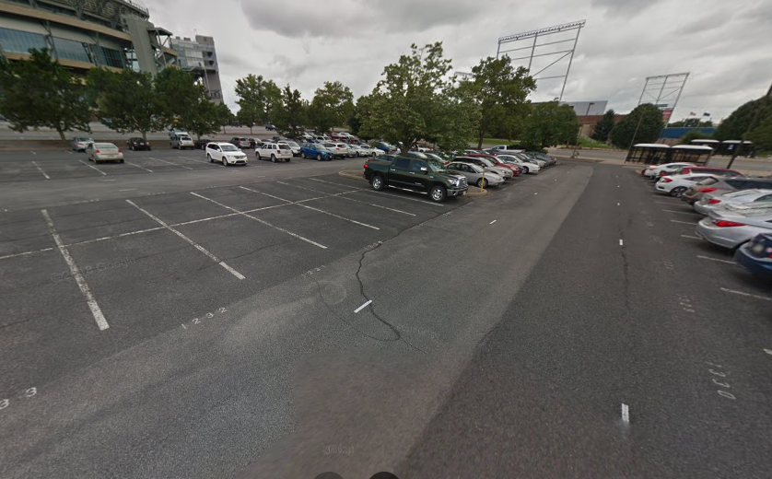
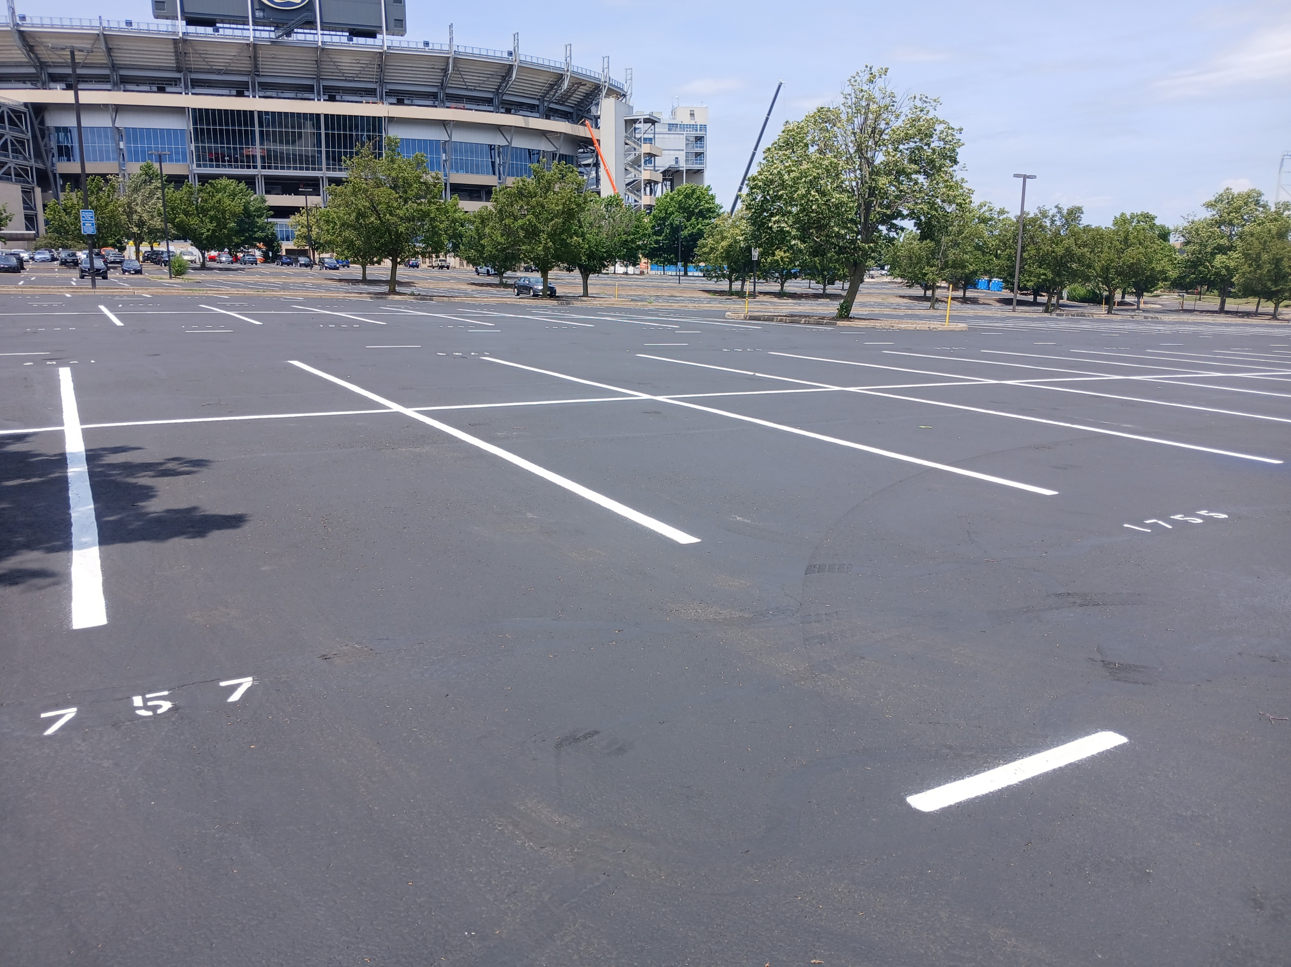
Projects Status: Where We Started vs. Where We Are Now
Notes:
FILLER SLIDES IF NEEDED
Jordan East Crack Seal, Sealcoat and new line striping in 2024.
Large Lot in extremely high-profile area. Programmed preventative maintenance is important to reduce the cost of deterioration and avoid increasing deferred maintenance costs. Also important for aesthetics in a highly visible area of campus.

Slide 25
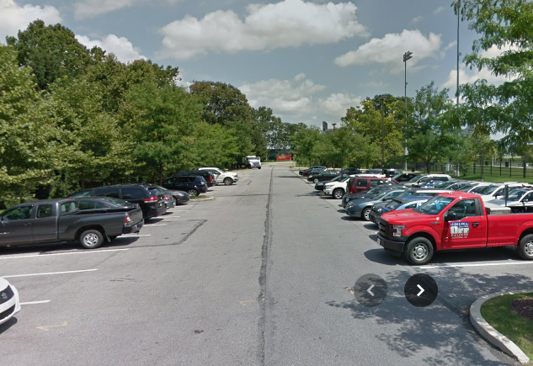
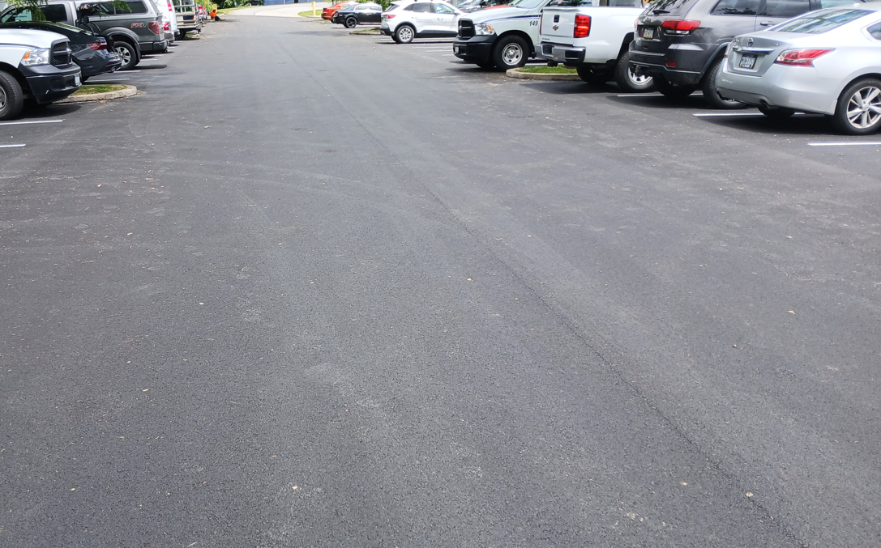
Projects Status: Where We Started vs. Where We Are Now
Notes:
Orange B Softball – mill and overlay surface course 2024.
Programmed maintenance was performed here for the second time since the program inception. Base repairs were completed during the last cycle. Having that work complete, made the mill and overlay process much simpler and less expensive during this cycle.

Slide 26
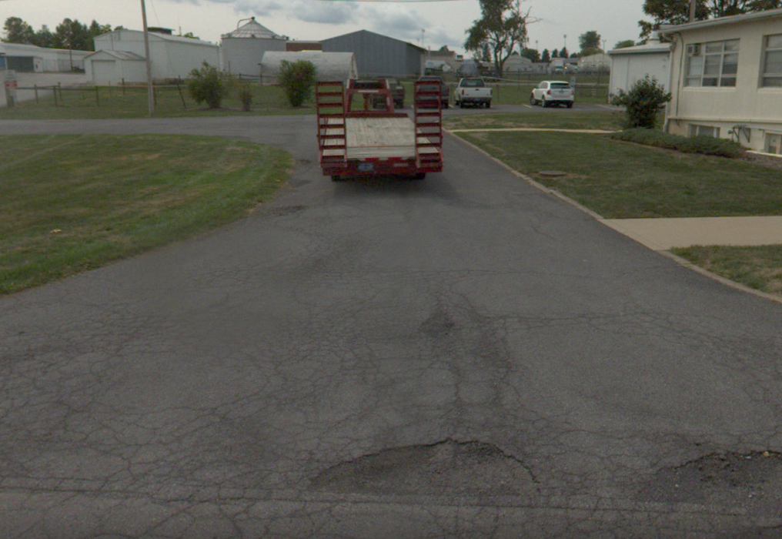
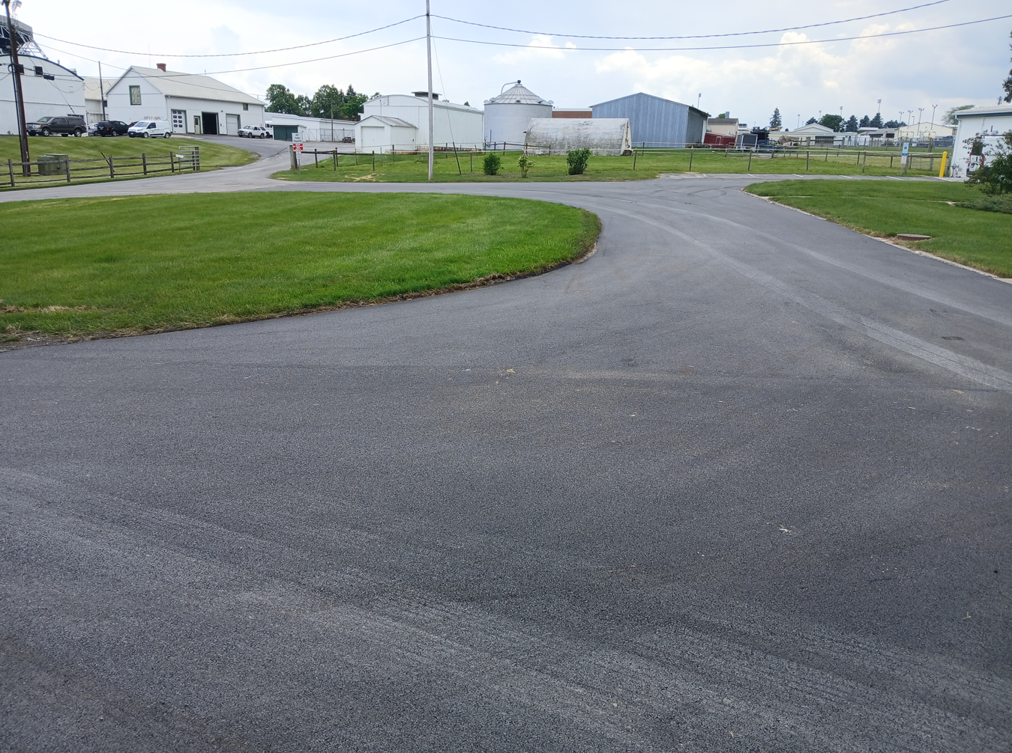
Projects Status: Where We Started vs. Where We Are Now
Notes:
Almquist Area – mill and overlay surface course with base repairs 2024
This is an area that is typically off the radar of most maintenance managers. Because we had the area in our inventory, our maintenance prioritization tool provided us a yearly reminder that something needed to be done before it failed completely and became very expensive. We had some long discussions about the fiscal responsibility for maintenance of the different pavement areas in this location. This year, we were able get a project done that aligned fiscal responsibility for two groups. We were able to perform a single scope maintenance operation for the whole area avoiding a piecemeal situation. Disruptions were limited for the customer, the project was constructible for the contractor, future maintenance options were improved for us, the maintenance managers.

Slide 27
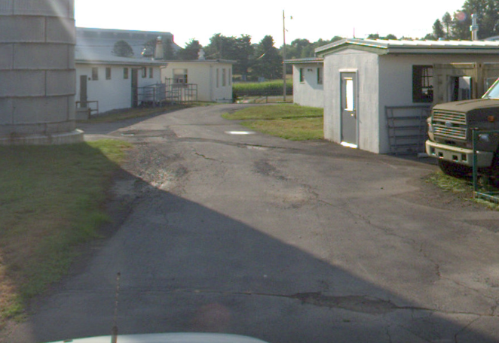
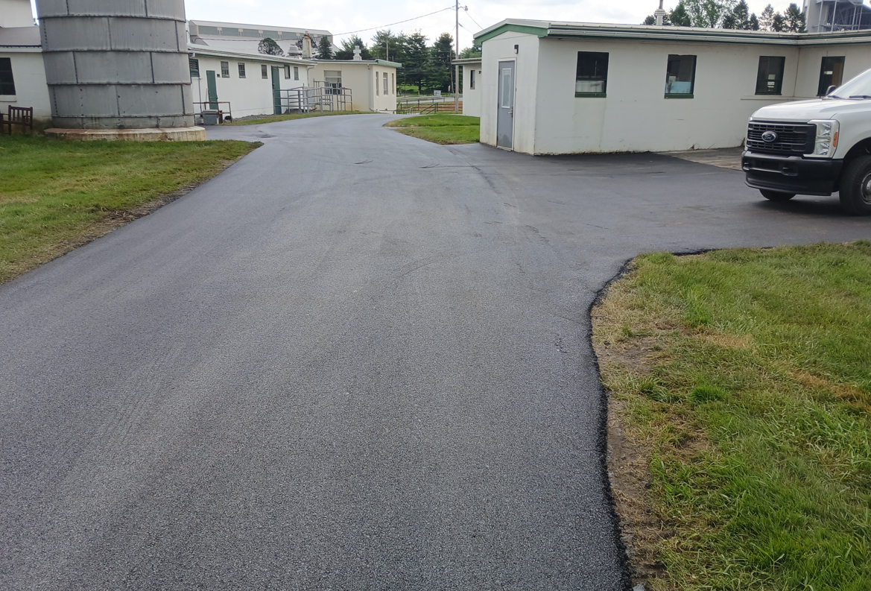
Projects Status: Where We Started vs. Where We Are Now
Notes:
Almquist Area – mill and overlay surface course with base repairs 2024

Slide 28
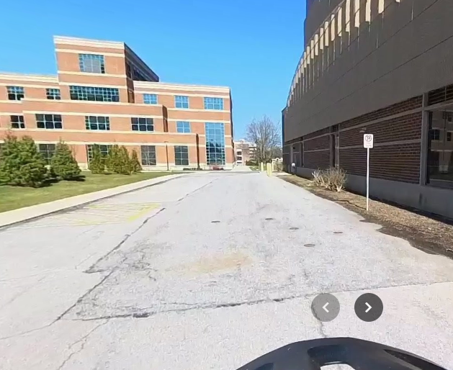
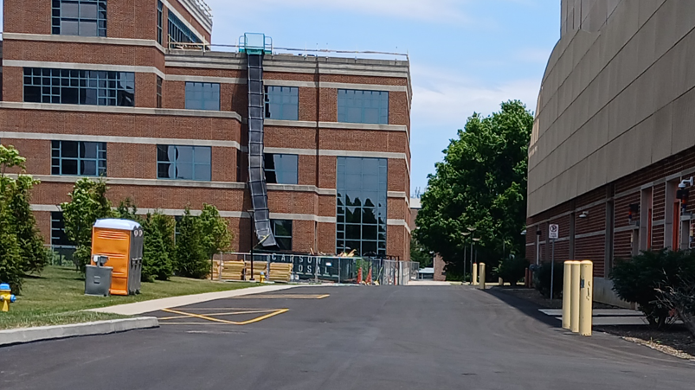
Projects Status: Where We Started vs. Where We Are Now
Notes:
Red K Parking Lot – Mill and overlay surface course 2024
This one is here just because it looks nicer.

